Slide 1

SMART IOT-BASED ENERGY-EFFICIENT
INTELLIGENT BUILDING AUTOMATION SYSTEM
WITH ESP32 AND IOT-BASED CONNECTIVITY
ECA5604 – 5G/6G Communication Systems
Presented by: GUIDED BY:
R.K RIBU (19122260359)

Slide 2
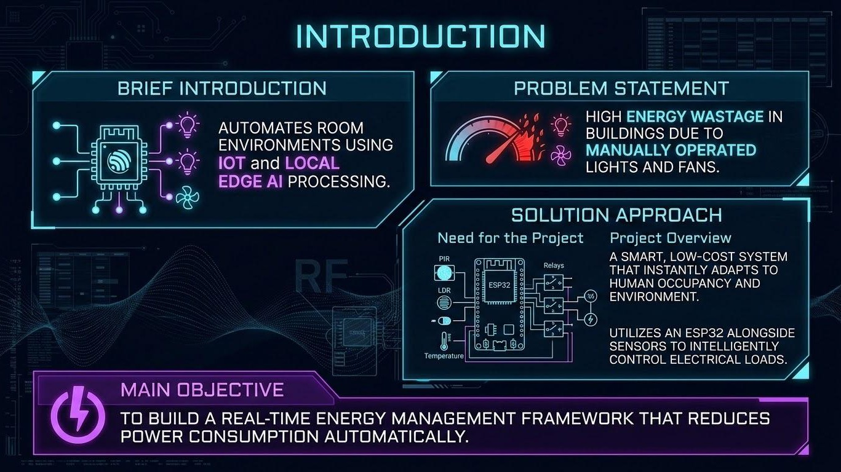
INTRODUCTION
Smart building system for automatic energy management.
Uses ESP32 and IoT technology.
Collects real-time room conditions using sensors.
Automatically controls electrical loads.

Slide 3

OBJECTIVES
Manual control causes unnecessary energy consumption.
Lights and fans may remain ON when not required.
Lack of real-time monitoring makes energy management difficult.

Slide 4
PROBLEM STATEMENT
Manual control causes unnecessary energy consumption.
Lights and fans may remain ON when not required.
Lack of real-time monitoring makes energy management difficult.
Main Objective
To reduce energy consumption through intelligent, automatic, and real-time building control.

Slide 5
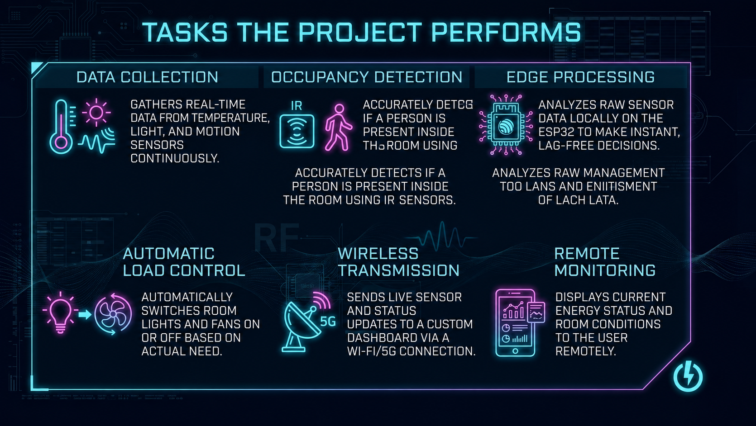
Tasks the Project Performs
Data Collection
Occupancy Detection
Edge Processing
Automatic Load Control
Wireless Communication
Remote Monitoring

Slide 6
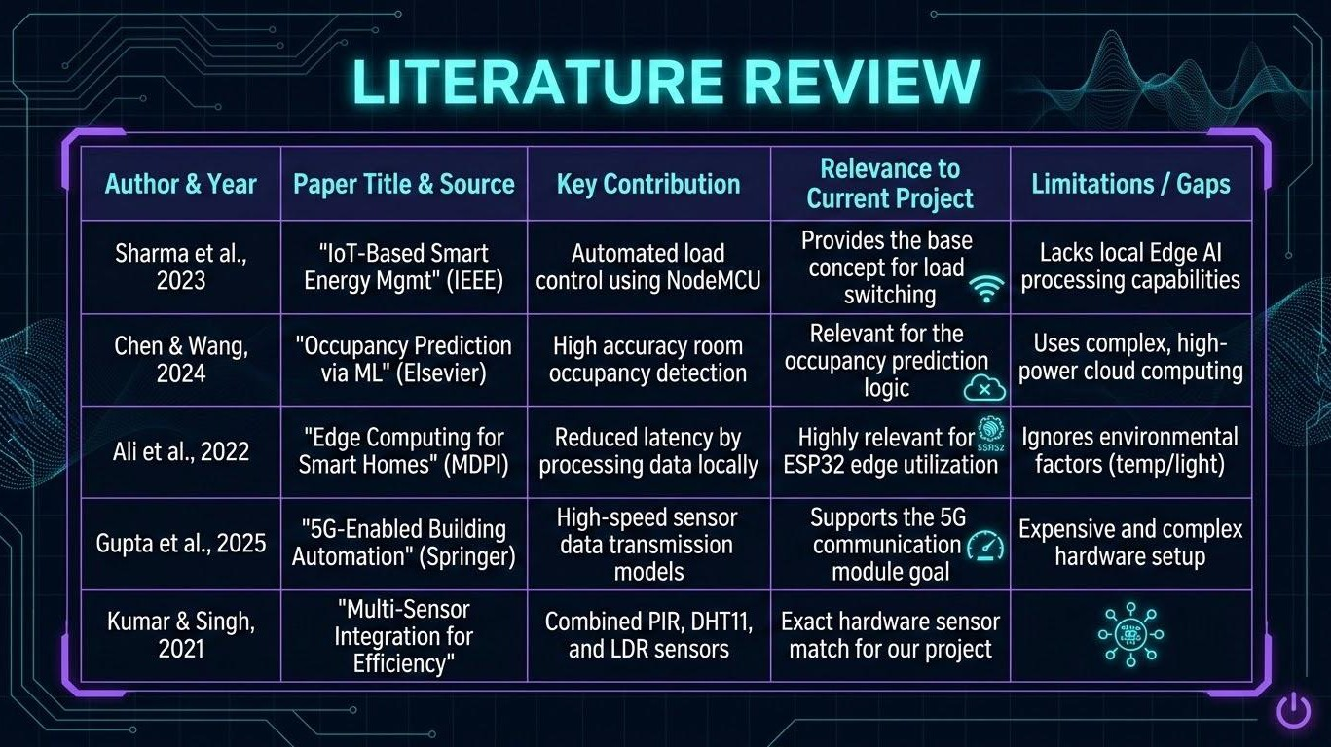
LITERATURE REVIEW

Slide 7
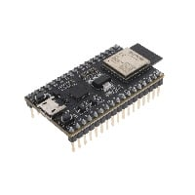
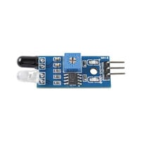
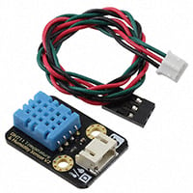
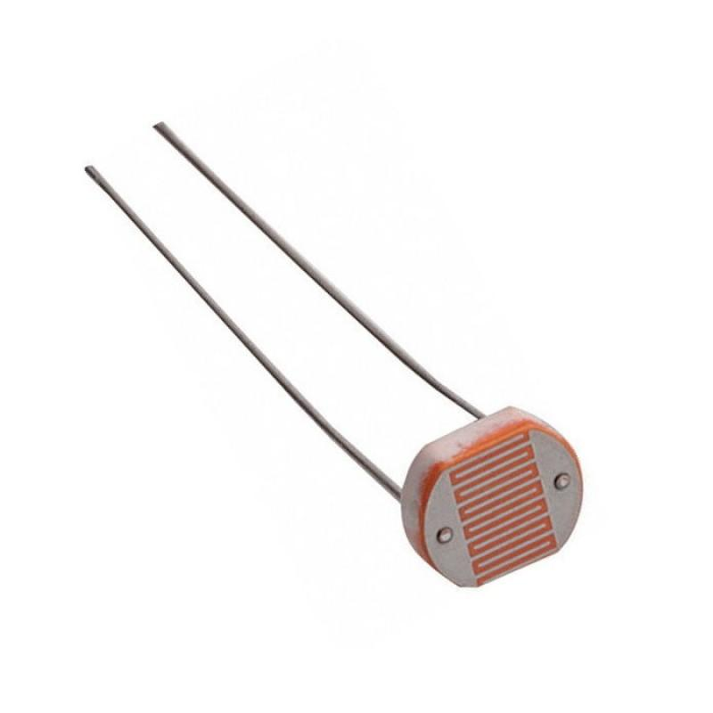
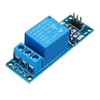
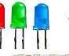
COMPONENTS REQUIRED
ESP32 Development Board
IR Sensor
DHT11 Sensor
LDR Sensor
Relay Module
LED
5V Power Supply
Breadboard
Connecting Wires

Slide 8
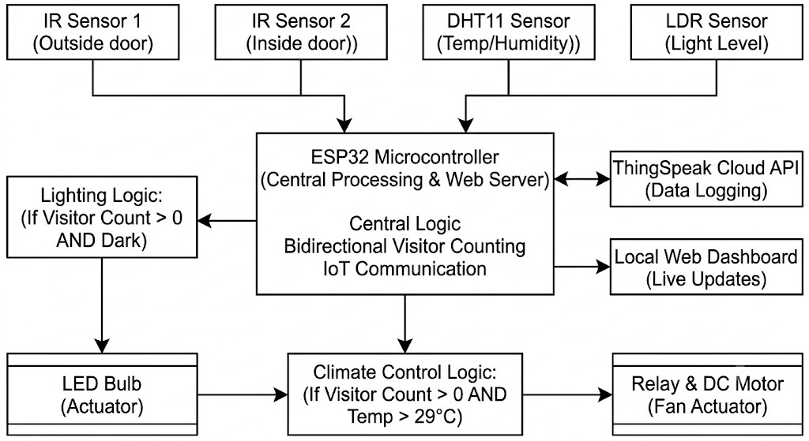
SYSTEM ARCHITECTURE

Slide 9
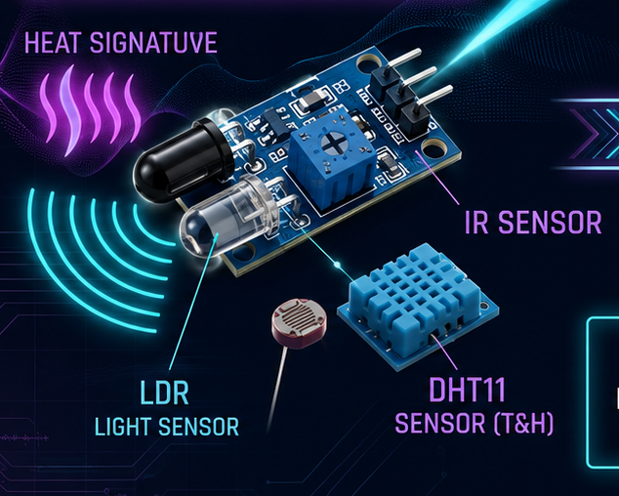
MODULE 1: SENSOR DATA COLLECTION
Inputs
IR Sensor 1 – Outside door
IR Sensor 2 – Inside door
DHT11 – Temperature & humidity
LDR – Light level
Function
Collects real-time sensor information.
Sends all readings to the ESP32.
Provides the input data required for automation.

Slide 10
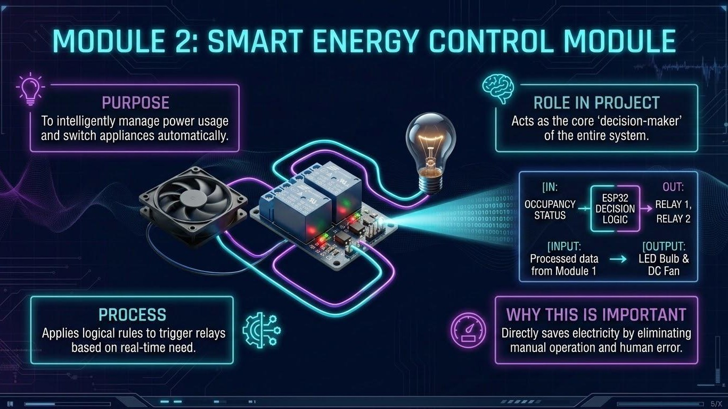
MODULE 2: SMART ENERGY CONTROL MODULE
Purpose
Automatically controls lighting and fan based on room conditions.
Reduces unnecessary energy consumption.
Input
Visitor Count
LDR Light Level
DHT11 Temperature
Control Logic
Visitor Count > 0 + Dark → LED ON
Visitor Count > 0 + Temperature > 29°C → Fan ON
Otherwise → Loads OFF

Slide 11
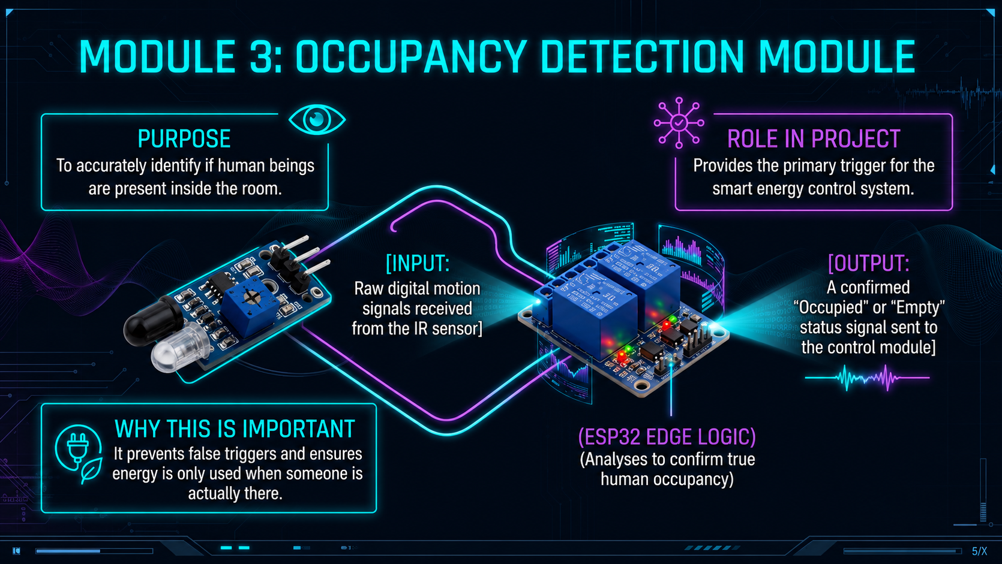
MODULE 3: OCCUPANCY DETECTION MODULE
Purpose
Detects whether people are entering or leaving the room.
Maintains the current visitor count.
Input
IR Sensor 1 – Outside the door
IR Sensor 2 – Inside the door
Working
IR1 → IR2 = Entry → Count increases
IR2 → IR1 = Exit → Count decreases
ESP32 continuously updates the visitor count.

Slide 12
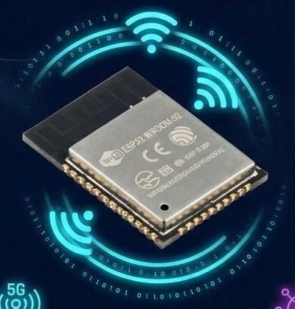
MODULE 4: Wi-Fi COMMUNICATION MODULE
Purpose
Provides wireless communication using the ESP32's built-in Wi-Fi.
Transfers sensor and system data for remote monitoring.
Input
Visitor Count
Temperature & Humidity
Light Level
LED and Fan Status
Working
ESP32 collects and processes the sensor data.
Wi-Fi connects the ESP32 to the network.
Data is sent to the Thing Speak Cloud API and Local Web Dashboard.

Slide 13
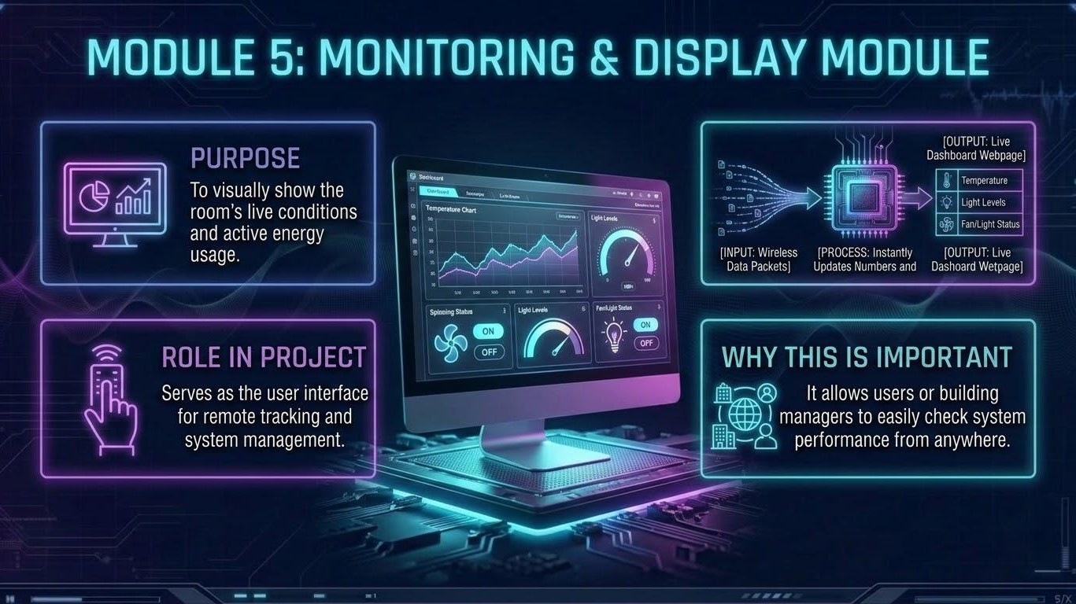
MODULE 5: MONITORING AND DISPLAY MODULE
Purpose
Displays the real-time status of the smart building system.
Helps the user monitor room conditions remotely.
Data Displayed
Temperature
Humidity
Light Level
LED Status
Fan Status
Working
ESP32 collects and processes sensor data.
Processed data is sent through Wi-Fi.
Data is displayed on the Local Web Dashboard.

Slide 14
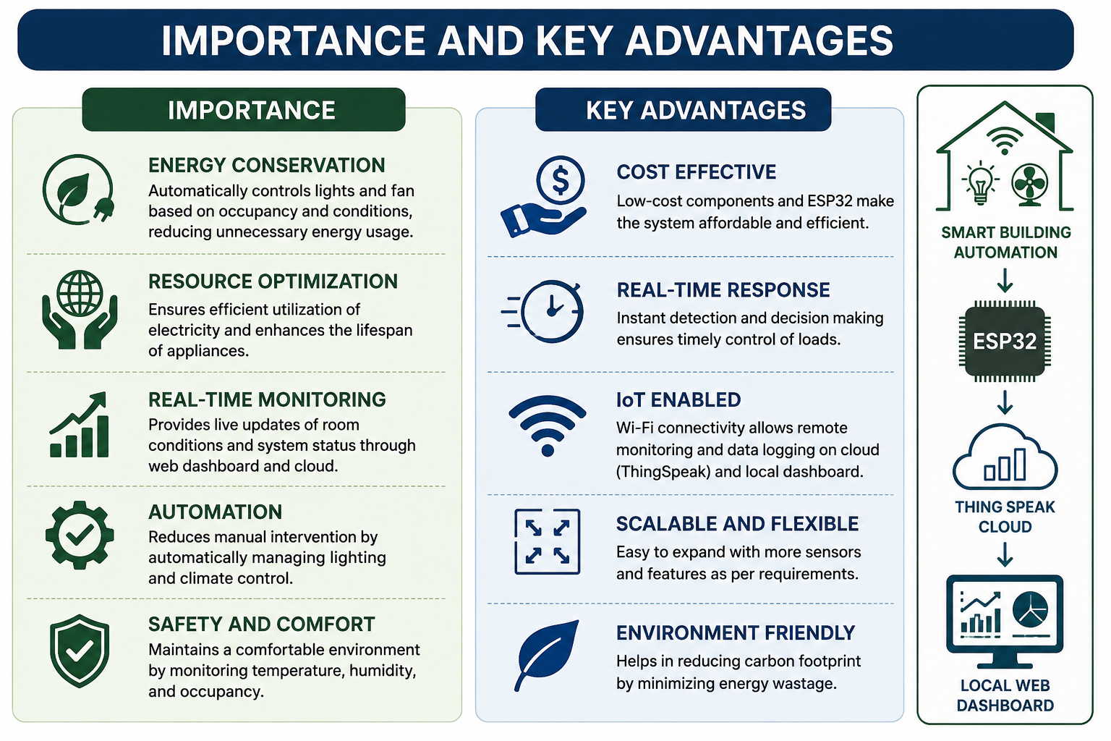
IMPORTANCE AND KEY ADVANTAGES

Slide 15
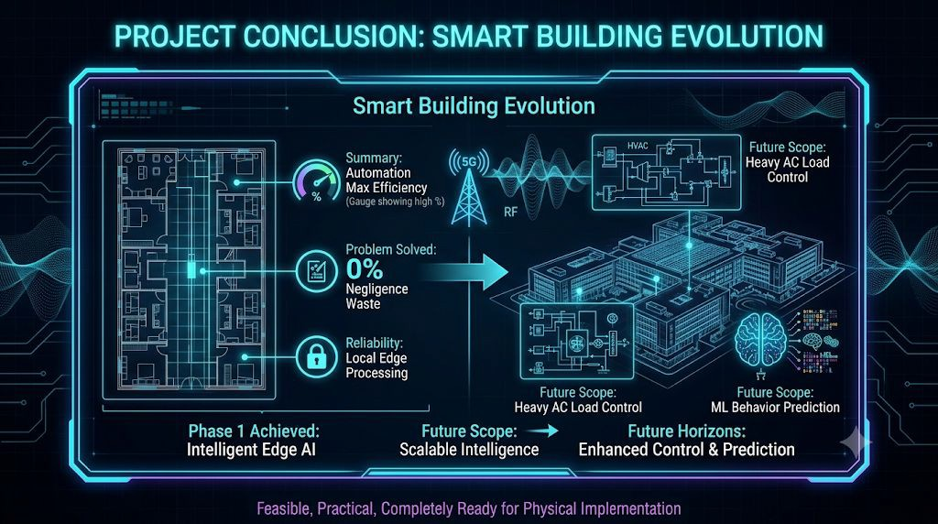
CONCLUSION
ESP32 enables smart and automatic energy management.
IR sensors provide accurate visitor counting.
DHT11 and LDR enable condition-based control.
IoT connectivity provides real-time monitoring and data logging.

Slide 16


